Slide 1
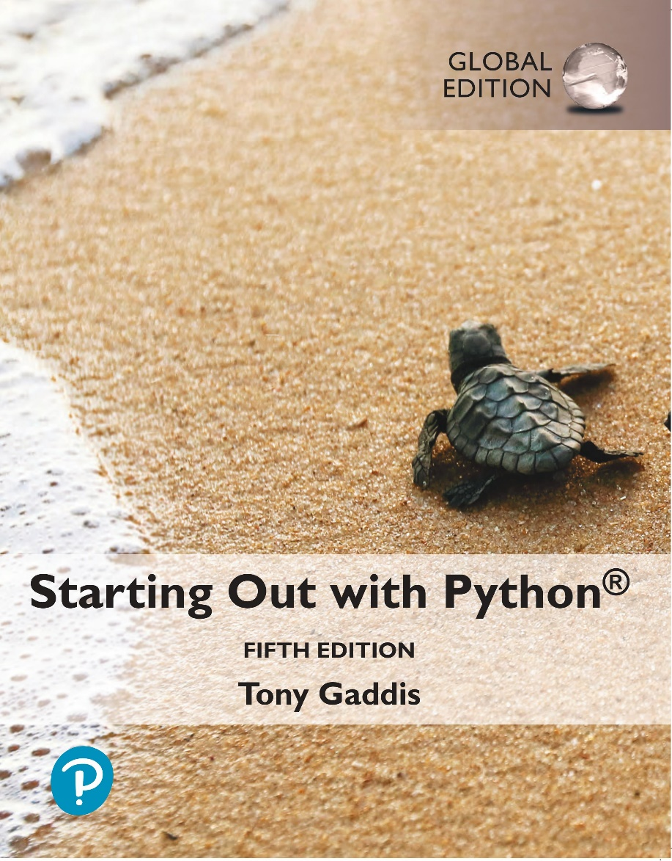
Starting out with Python
Fifth Edition, Global Edition
Chapter 2
Input, Processing, and Output
Copyright © 2022 Pearson Education, Ltd. All Rights Reserved.

Slide 2
Topics
Designing a Program

Slide 3
Designing a Program (1 of 4)
Programs must be designed before they are written
Program development cycle:
Design the program
Write the code
Correct syntax errors
Test the program
Correct logic errors

Slide 4
Designing a Program (2 of 4)
Design is the most important part of the program development cycle
Understand the task that the program is to perform
Work with customer to get a sense what the program is supposed to do
Ask questions about program details
Create one or more software requirements

Slide 5
Designing a Program (3 of 4)
Determine the steps that must be taken to perform the task
Break down required task into a series of steps
Create an algorithm, listing logical steps that must be taken
Algorithm: set of well-defined logical steps that must be taken to perform a task

Slide 6

Designing a Program (4 of 4)
An algorithm to calculate and display the gross pay for an hourly paid employee:

Slide 7
Pseudocode (1 of 3)
Pseudocode: fake code
Informal language that has no syntax rule
Not meant to be compiled or executed
Used to create model program
No need to worry about syntax errors, can focus on program’s design
Can be translated directly into actual code in any programming language

Slide 8

Pseudocode (2 of 3)

Slide 9
Pseudocode (3 of 3)
Soru: Baz fiyatı verilen bir otomobilin ÖTV (%45), KDV (%18) ve toplam vergi tutarlarını bulun:

Slide 10
Flowcharts (1 of 2)
Flowchart: diagram that graphically depicts the steps in a program
Ovals are terminal symbols
Parallelograms are input and output symbols
Rectangles are processing symbols
Symbols are connected by arrows that represent the flow of the program

Slide 11
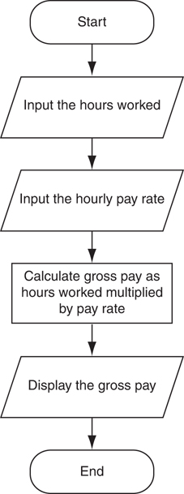
Flowcharts (2 of 2)
Figure 2-2 The program development cycle

Slide 12
Summary
This chapter covered:
The program development cycle, tools for program design, and the design process

